Slide 1


TTbar resonances Angular Distributions Status Report NTUA
George Bakas

Slide 2
Search for top-antitop resonances
Numerous extensions of the SM predict the existence of new interactions with enhanced couplings to third generation quarks, especially the top quark
The associated new particle → observation as a ttbar resonance
Examples of such resonances:
Massive Color-singlet Z like bosons (Z’)
Colorons
Axigluons
Heavier Higgs siblings
Kaluza-Klein excitations of gluons
Electroweak gauge bosons
Gravitons in various extensions of the Randall-Sundrum model
All of the above predict the existence of TeV-scale resonances with a cross section of a few pb’s
Resonant ttbar production would be observable in the reconstructed invariant mass of the ttbar system
Most analyses search for peaks in the invariant ttbar mass

Slide 3
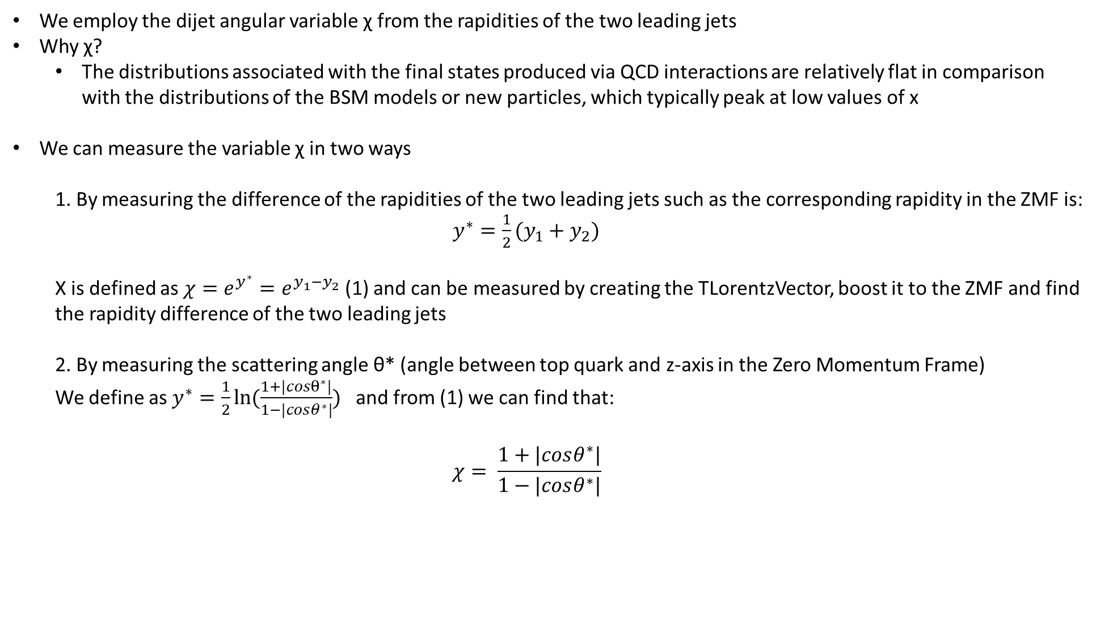
Variables
We employ the dijet angular variable χ from the rapidities of the two leading jets
Why χ?
The distributions associated with the final states produced via QCD interactions are relatively flat in comparison with the distributions of the BSM models or new particles, which typically peak at low values of x
We can measure the variable χ in two ways
1. By measuring the difference of the rapidities of the two leading jets such as the corresponding rapidity in the ZMF is: $y^{∗}=\frac{1}{2}(y_{1}+y_{2})$
Χ is defined as $χ=e^{y^{∗}}=e^{y_{1}−y_{2}}$ (1) and can be measured by creating the TLorentzVector, boost it to the ZMF and find the rapidity difference of the two leading jets
2. By measuring the scattering angle θ* (angle between top quark and z-axis in the Zero Momentum Frame)
We define as $y^{∗}=\frac{1}{2}ln⁡(\frac{1+|cosθ^{∗}|}{1−|cosθ^{∗}|})$ and from (1) we can find that:
$$χ= \frac{1+|cosθ^{∗}|}{1−|cosθ^{∗}|}$$

